Slide 1
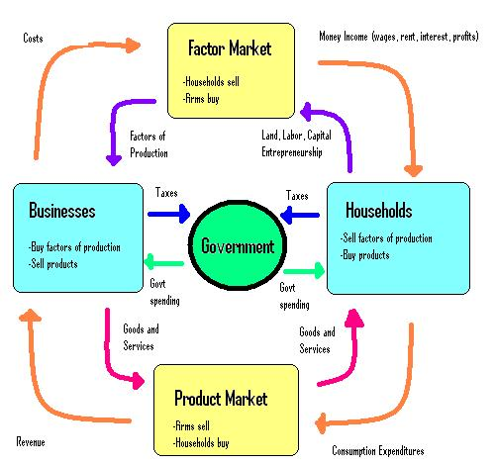
MACROECONOMICS
Lecture 02: The Circular Flow Models of an Economy
Dr. Hemantha Premarathne
Senior Lecturer
Department of Social Sciences
KDU

Slide 2
CIRCULAR FLOWS IN A TWO-SECTOR MODEL
The two-sector model consists of only households and firm sectors.
Households:
- Households are the owners of all factors of production (Land, Labor, Capital & Entrepreneurship).
- Their total income consists of returns on their factors of production (rent, wages, interest and profit).
- They are the consumer of all the consumer goods and services.
- They spend their total income on goods and services produced by the firms.

Slide 3
Cont…..
Business Firms:
- Firms own no resources of their own.
- They hire the factors of production from the household.
- They use factors to produce and sell goods to the HHs.
- They don’t save

Slide 4
Cont…..
Assumption of the Model:
- There are two sectors, HH & Firms.
- HHs spend their total income on consumer and capital goods produced by the firms.
- Firms produce goods and services only as much as demanded by the HHs .
- Firms make factor payments to the HHs as rent, wages, interest and profits.
- There are no inflow or outflow of income or of goods and services from any outside source.

Slide 5
The Circular Flows in a Two-Sector Economy: A Graphic Presentation
Land, Labor, Capital & Entrepreneurship
Rent, Wage, Interest, Profit
Household Sector
Firm Sector
Expenditure
Goods & Services

Slide 6
Cont…..
The upper half represents the factor market and the lower half represents the commodity market.
In the factor market, the arrow shows the flow of factors of production from the HHs to firms.
The factor flow causes another flow, that is, the flow of factor income ( wages, interest, rent and profit) from the firms to the HHs.
In the commodity market, the goods and services produced by the firms flow from the firms to the HHs.
Payments for the goods & services are made by the households.
By combining the continuous arrows in the factor and commodity markets, we get the circular flow model.

Slide 7
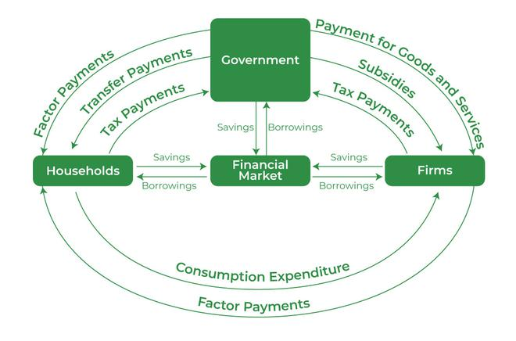
The Circular Flows with the Government

Slide 8
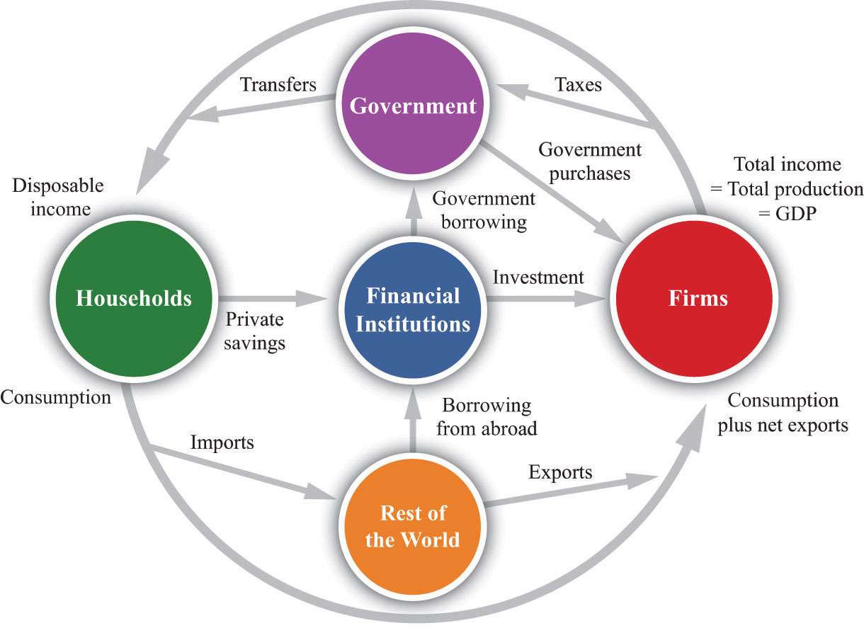
The Circular Flows with the International Sector

Slide 9
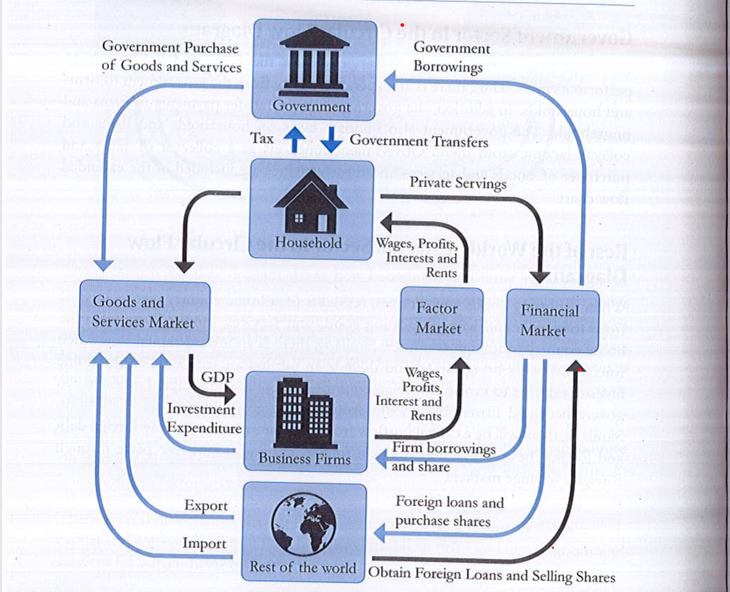

Slide 10
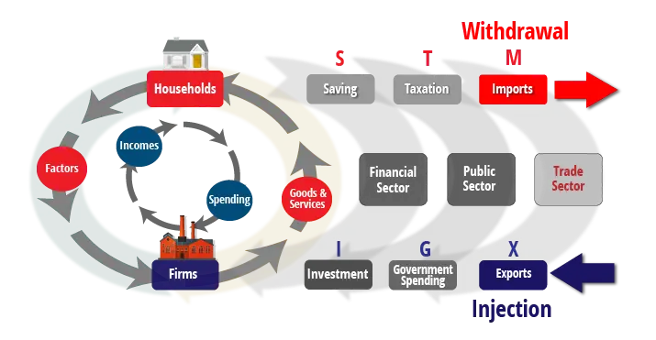
The Circular Flows – Withdrawals and Injections

Slide 11
The End

